Slide 1
Outline
Describing the fundamentals of distributed systems
Defining blockchain technology
Understanding how blockchain technology was developed
Detailing the elements of a blockchain
Identifying the benefits and limitations of blockchain technology

Slide 2

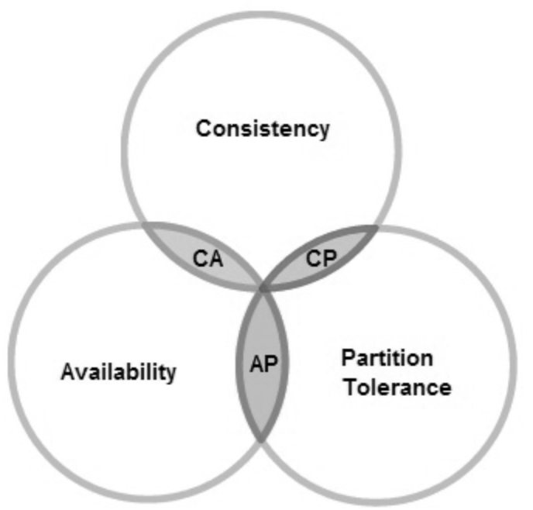
Introduction
Blockchain is a new revolutionary technology that will change our lives. In this chapter we will cover the theory of blockchain technology, and its technical foundations.

Slide 3
Introducing distributed computing
A distributed system is a computing paradigm whereby two or more nodes work with one another, in a coordinated fashion, to achieve a common outcome.
A distributed system is modeled in such a way that end users see it as a single logical platform.
Examples include clusters and clouds.

Slide 4
The Byzantine Generals problem
Attack?
5
?
Attack
Retreat
?
Retreat
?
Attack
?
Attack or retreat?
Consensus required to win

Slide 5
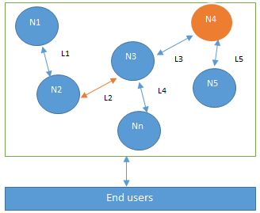
Design of a distributed system
N4 is a Byzantine node, L2 is broken or a slow network link

Slide 6
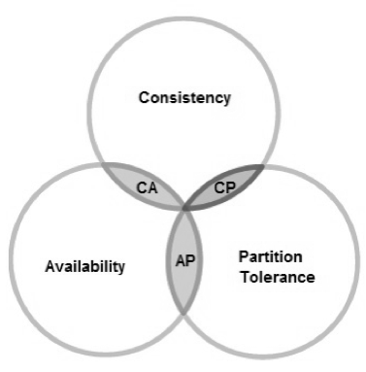
CAP theorem
This states that a distributed system cannot have all three of the desired properties simultaneously; that is:
Consistency
Availability
Partition tolerance

Slide 7
Types of faults in distributed systems
Fail-stop faults (crash faults)
Where components crash or cease to operate
Simpler to deal with
Byzantine faults
Where components are potentially untrustworthy or malicious
Difficult to deal with

Slide 8
Defining ‘Blockchain’
Layman's definition: Blockchain is an ever-growing, secure, shared recordkeeping system in which each user of the data holds a copy of the records, which can only be updated if all parties involved in a transaction agree to update.
Technical definition: Blockchain is a peer-to-peer distributed ledger that is cryptographically-secure, append-only, immutable (extremely hard to change), and updateable only via consensus or agreement among peers.

Slide 9
Blockchain definition
Peer-to-peer
Distributed ledger
Cryptographically secure
Append only
Updateable via consensus (consensus-driven)

Slide 10
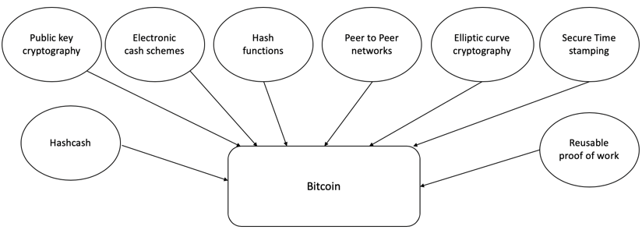
How did blockchain technology develop?
1950s – Hash functions
1970s – Merkle trees - hashes in a tree structure
1970s continued – Research in distributed systems, consensus, state machine replication
1980s – Hash chains for secure logins
1990s – e-Cash for e-payments
1991 – Secure timestamping of digital documents.
1992 – Hashcash idea to combat junk emails
1994 – S/KEY application for Unix login.
1997/2002 – Hashcash
2008/2009 – Bitcoin (the first blockchain)

Slide 11
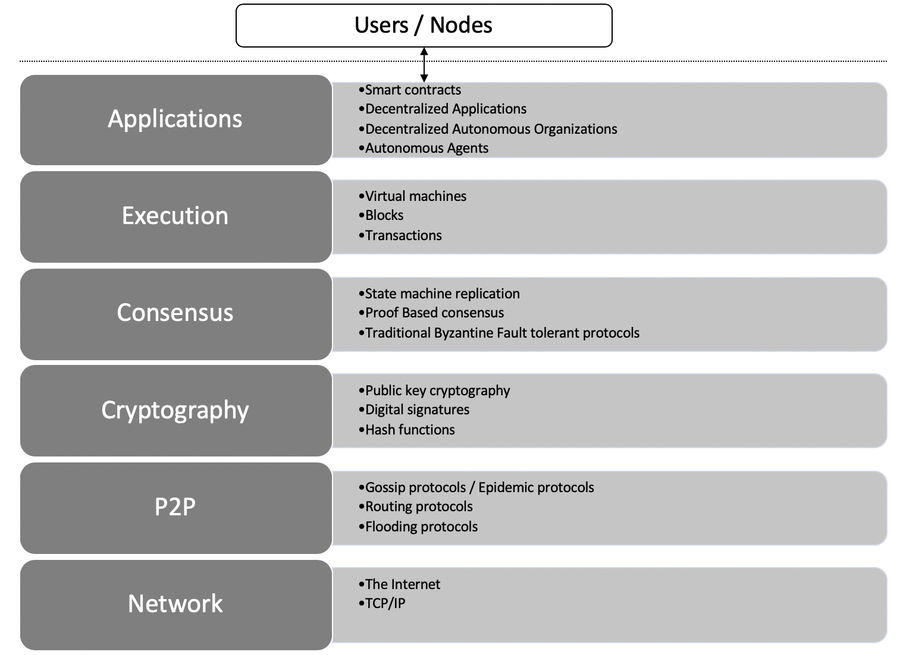
Architectural view of Blockchain

Slide 12
Generic structure of a blockchain
Genesis block
Transactions & other data
Previous hash
Block 1
Transactions & other data
Previous hash
Block 2
Transactions & other data
Previous hash
Block N
Transactions & other data
. . . . .

Slide 13
Generic elements of a blockchain
Addresses
Accounts
Transactions
Blocks
Peer-to-peer network
Scripting or programming language
Virtual machine
State machine
Nodes
Smart contracts

Slide 14








How a blockchain works
1. User X transacts with User Y
2. Transaction broadcast
3. Find new block (mining)
4. New block found (mined)
Smart contract or transfer of value
5. Add new block to the blockchain

Slide 15
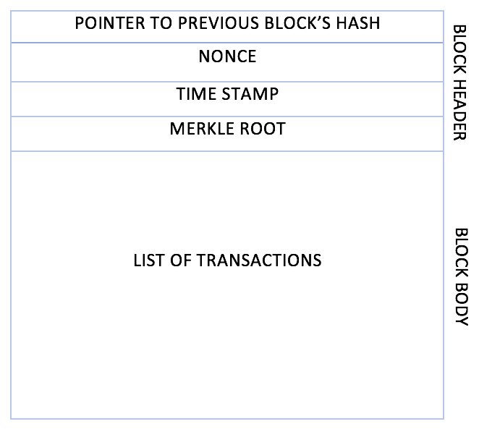
Generic block structure

Slide 16
Benefits of blockchain
Decentralization
Transparency
Trust
Immutability
High availability
Highly secure
Simplification of current paradigms
Faster transactions
Cost saving

Slide 17
Limitations of blockchain
Scalability
Adaptability
Regulation
Relatively immature technology
Privacy

Slide 18
Features of a blockchain
Distributed consensus
Transaction verification
Platform for smart contracts
Transferring value between peers
Generation of cryptocurrency
Provider of security
Immutability
Uniqueness

Slide 19
Exercise
Think about a scenario where blockchain can solve a challenge at your place of work or education, or in your community.
Read the Bitcoin paper at https://bitcoin.org/bitcoin.pdf

Slide 20
Summary
In this presentation, we:
Covered the design of a distributed system and faults in distributed systems.
Defined blockchain as a distributed ledger—a replicated digital ledger which is immutable and updateable only via consensus.
Introduced precursors to blockchain technology such as hash functions, consensus mechanisms, Hashcash, and e-cash schemes.
Explored various elements of a blockchain, such as addresses, peer-to-peer networks, blocks, and transactions.
Considered the benefits and limitations of blockchain technology.

Slide 21



INSTITUTE : UIE
DEPARTMENT : CSE
Bachelor of Engineering (Computer Science & Engineering)
Disruptive Technologies-3
(23CSH-203)
Topic: Blockchain
DISCOVER . LEARN . EMPOWER
Notes:
1

Slide 22
Learning Objectives & Outcomes
Objective:
To understand the meaning of cloud and cloud Computing
Outcome:
Student will understand
The meaning of cloud and cloud Computing
How its works

Slide 23
Blockchain

Slide 24
Blockchain
Blockchain is the backbone Technology of Digital CryptoCurrency BitCoin. Blockchaintechnology is a digital or ledger technology that evaluates the records and makes track of it in a peer-to-peer network. Each transaction is verified by the majority of participants of the system. It contains every single record of each transaction.

Slide 25
Benefits of Blockchain Technology
The following are some of the benefits of blockchain technology:
1. Efficiency: By simplifying these methods with blockchain, dealings can be achieved quickly and more efficiently.
Efficiency only indicates that transactions once registered on the blockchain, can’t be modified or removed.
On the blockchain, all transactions are timely and date-wise noted, so there’s a permanent chronology.
Therefore, blockchain can be employed to track information over the short and long term, allowing a secure, trustworthy version of knowledge.
Blockchain is utilized to digitize genuine estate transactions to keep control of property headers.
11

Slide 26
Benefits of Blockchain Technology
2. Transparency: Blockchain produces a track that establishes the origin of an investment at every step of its records. It is achievable to transfer data regarding origin directly with clients.
Transparency is one of the major difficulties in the IT world.
To enhance transparency, associations have attempted to execute more rules and protocols.
The main goal of the blockchain is to make the business model transparent which includes transactions, wallets, etc.
So that no single individual can make the changes without knowing other participants in the business model.

Slide 27
Benefits of Blockchain Technology
3. Security: By building a document that can’t be changed and is encrypted end to end, blockchain allows for preventing copying and unauthorized movement. Privacy problems can likewise be managed on blockchain by individual data and individual authorizations to maintain access.
It focuses on the security part also as blockchain is mainly known for its security.
The security is so tight that it is very difficult to hack the ledger and steal or manipulate the information because of using a consensus algorithm.
Any trades that are ever registered require to be decided upon according to the agreement approach.
Furthermore, the individual transaction is encrypted and has a verified connection with the previous transactions with help of hashing algorithms.

Slide 28
Benefits of Blockchain Technology
Network distribution: When users load data into the approach, users cannot modify it and it’s hard to eliminate. Even small differences can be traceable, tracked, and registered then distributed on the blockchain ledger for all to view.
It also concentrates on educating or making awareness regarding network distribution.
This particular supplies, at the identical moment, various advantages, by having this network distributed, in the foremost example, no one holds the network, permitting various users to consistently have numerous documents of the exact data.
Moreover, this feature causes it immune and distributed to any kind of defeat as the point that a node dies accomplishes not suggest generalized failures in the P2P network.

Slide 29
Benefits of Blockchain Technology
5. Traceability: With blockchain technology, users can stop all of the errors. Users’ store chains can evolve totally translucent and manageable to track. It allows users to join, outline, and track goods or assets to confirm they are not misapplied or returned during the procedure.
Participants or members can easily track their business model using blockchain.
This will increase the growth of businesses as they will get the fault at the right time.
In blockchain technology, the collection chain evolves better transparently than ever.
It allows every group to trace the interests and confirm that it is not substituted or misapplied during the collection chain approach.
Associations can also create the most out of blockchain traceability by executing it in place.

Slide 30
Benefits of Blockchain Technology
6. Reduced Costs: It delivers protected surroundings where encrypted enterprise transactions between customer and seller can transpire without the requirement for third groups to moderate.
Associations desire to decrease costs and delay the funds into creating something unique or enhancing existing approaches.
By operating blockchain, associations can obtain at cheaper costs associated with third-party agents.
Blockchain includes no inherited centralized performer, there is no necessity to consume on any dealer charges.
Moreover, there is a minor exchange must when it comes to validating a trade.

Slide 31
Benefits of Blockchain Technology
7. Availability: Parties of blockchain P2P networks can get shut down from analyzing the shape and correcting it when union producers submit the condition of the design.
Higher availability, efficiency, confidentiality, and flexibility to adjust any desired solution model.
The data can be recovered by users from anywhere around the world.
The availability is higher as productivity increases by using blockchain because it divides each section into each department so that every individual can focus on a particular task or work.

Slide 32
Benefits of Blockchain Technology
8. Automation: Blockchain transactions can be automated with smart contracts. Using smart contracts increases efficiency and speeds up the process. Once the pre-specified conditions in smart contracts are met then the next steps in the transaction or process are automatically triggered.
Smart contracts reduce human intervention.
They also reduce reliance on third parties to verify that the terms of the contracts have been met.

Slide 33
Benefits of Blockchain Technology
9. Decentralized: Blockchain technology is used to hold data in a decentralized manner so everyone can confirm the accuracy or correctness of the data by using nil understanding evidence via which one group confirms the correctness of data to another group without disclosing anything regarding the information.
Decentralization indicates the transfer of control and judgment created from a centralized organization to a P2P network.
These networks attempt to reduce the level of trust that partners should put in individually and prevent their ability over each other.
It creates blockchain and enhances security for users.
In demand for someone to meddle with the blockchain, they would have to meddle with all the units of the chain and hack every node, which is unthinkable.

Slide 34
Benefits of Blockchain Technology
10. Tokenization: Tokenization is the method where the worth of an asset including digital as well as material, is transformed into a digital token that is then registered on and then transmitted through blockchain.
It has been noticed with digital skills and other virtual support, but tokenization has more general applications that could smooth business transactions.
It is used to change carbon emission fundings under carbon cap schedules.

Slide 35
Advantages of Blockchain Technology:
Open: One of the major advantages of blockchain technology is that it is accessible to all means anyone can become a participant in the contribution to blockchain technology, one does not require any permission from anybody to join the distributed network.
Verifiable: Blockchain technology is used to store information in a decentralized manner so everyone can verify the correctness of the information by using zero-knowledge proof through which one party proves the correctness of data to another party without revealing anything about data.
Permanent: Records or information which is stored using blockchain technology is permanent means one needs not worry about losing the data because duplicate copies are stored at each local node as it is a decentralized network that has a number of trustworthy nodes.
Free from Censorship: Blockchain technology is considered free from censorship as it does not have control of any single party rather it has the concept of trustworthy nodes for validation and consensus protocols that approve transactions by using smart contracts.

Slide 36
Advantages of Blockchain Technology:
Tighter Security: Blockchain uses hashing techniques to store each transaction on a block that is connected to each other so it has tighter security. It uses SHA 256 hashing technique for storing transactions.
Immutability: Data cannot be tampered with in blockchain technology due to its decentralized structure so any change will be reflected in all the nodes so one cannot do fraud here, hence it can be claimed that transactions are tamper-proof.
Transparency: It makes histories of transactions transparent everywhere all the nodes in the network have a copy of the transaction in the network. If any changes occur in the transaction it is visible to the other nodes.
Efficiency: Blockchain removes any third-party intervention between transactions and removes the mistake making the system efficient and faster. Settlement is made easier and smooth.
Cost Reduction: As blockchain needs no third man it reduces the cost for the businesses and gives trust to the other partner.

Slide 37
Disadvantages of Blockchain Technology:
This section discusses the disadvantages of blockchain technology.
Scalability: It is one of the biggest drawbacks of blockchain technology as it cannot be scaled due to the fixed size of the block for storing information. The block size is 1 MB due to which it can hold only a couple of transactions on a single block.
Immaturity: Blockchain is only a couple-year-old technology so people do not have much confidence in it, they are not ready to invest in it yet several applications of blockchain are doing great in different industries but still it needs to win the confidence of even more people to be recognized for its complete utilization.
Energy Consuming: For verifying any transaction a lot of energy is used so it becomes a problem according to the survey it is considered that 0.3 percent of the world’s electricity had been used by 2018 in the verification of transactions done using blockchain technology.
Time-Consuming: To add the next block in the chain miners need to compute nonce values many times so this is a time-consuming process and needs to be speed up to be used for industrial purposes.
Legal Formalities: In some countries, the use of blockchain technology applications is banned like cryptocurrency due to some environmental issues they are not promoting to use blockchain technology in the commercial sector.
Storage: Blockchain databases are stored on all the nodes of the network creates an issue with the storage, increasing number of transactions will require more storage.
Regulations: Blockchain faces challenges with some financial institution. Other aspects of technology will be required in order to adopt blockchain in wider aspect.

Slide 38
Best Applications of Blockchain in the Real World
Blockchain is distributed which means everyone obtains a copy in the case of a public blockchain. So it is very difficult to modify the data in the blockchain because to do so every copy in every location would need to be changed (which is near to impossible) This makes blockchain both distributed and immutable along with maintaining transparency as the data in the block is not hidden in any way. All of these properties of blockchain ensure the highest levels of security which is why it is so popular in many applications that prioritize security and transparency. Nowadays, Blockchain applications are used by companies on a large scale.

Slide 39
Best Applications of Blockchain in the Real World
1. Asset Management
2. Cross-Border Payments
3. Healthcare
4. Cryptocurrency
5. Birth and Death Certificates
6. Online Identity Verification
7. Internet of Things
8. Copyright and Royalties

Slide 40
References
Text books:
Blockchain Technology: Algorithms and Applications Paperback – 6 December 2023 by Asharaf S.; (Author), Sivadas Neelima (Author), Adarsh S. (Author), Franklin John (Author)
Blockchain Basics: A Non-Technical Introduction in 25 Steps
Book by Daniel Drescher
Websites:
https://ntiprit.gov.in/pdf/blockchainanddistributed/Blockchain_Introduction_KR.pdf
https://bitcoin.org/bitcoin.pdf

Slide 41
THANK YOU

Slide 42
INSTITUTE : UIE
DEPARTMENT : CSE
Bachelor of Engineering (Computer Science & Engineering)
Disruptive Technologies-3
(23CSH-203)
Topic: Blockchain
DISCOVER . LEARN . EMPOWER
Notes:
1

Slide 43
Blockchain

Slide 44
Components of Blockchain Network
Components of Blockchain Network As per the name ‘Blockchain‘, it itself suggests that information (i.e transactions) will be stored in the form of blocks. Every node can see the block, but they can’t tamper with them. If a block value is tampered the hash value associated with that block changes and that block will be disconnected from the network. On an average of 12.6 seconds, every node in the blockchain network gets the most updated blockchain. The technology behind Bitcoins is the Blockchain Network. Following are the components of a Blockchain network –
Node
Ledger
Wallet
Nonce
Hash

Slide 45
Components of Blockchain Network
1. Node – It is of two types – Full Node and Partial Node.
Full Node – It maintains a full copy of all the transactions. It has the capacity to validate, accept and reject the transactions.
Partial Node – It is also called a Lightweight Node because it doesn’t maintain the whole copy of the blockchain ledger. It maintains only the hash value of the transaction. The whole transaction is accessed using this hash value only. These nodes have low storage and low computational power.
2. Ledger – It is a digital database of information. Here, we have used the term ‘digital’ because the currency exchanged between different nodes is digital i.e cryptocurrency. There are three types of ledger. They are –
Public Ledger – It is open and transparent to all. Anyone in the blockchain network can read or write something.
Distributed Ledger – In this ledger, all nodes have a local copy of the database. Here, a group of nodes collectively execute the job i.e verify transactions, add blocks in the blockchain.
Decentralized Ledger – In this ledger, no one node or group of nodes has a central control. Every node participates in the execution of the job.
11

Slide 46
Components of Blockchain Network
3. Wallet – It is a digital wallet that allows user to store their cryptocurrency. Every node in the blockchain network has a Wallet. Privacy of a wallet in a blockchain network is maintained using public and private key pairs. In a wallet, there is no need for currency conversion as the currency in the wallet is universally acceptable. Cryptocurrency wallets are mainly of two types –
Hot Wallet – These wallets are used for online day-to-day transactions connected to the internet. Hackers can attack this wallet as it is connected to the internet. Hot wallets are further classified into two types – a. Online/ Web wallets – These wallets run on the cloud platform. Examples – MyEther Wallet, MetaMask Wallet. b. Software wallets – It consists of desktop wallets and mobile wallets. Desktop wallets can be downloaded on a desktop and the user has full control of the wallet. An example of a desktop wallet is Electrum. c. Mobile wallets – They are designed to operate on smartphone devices. Example – mycelium.

Slide 47
Components of Blockchain Network
Cold Wallet – These wallets are not connected to the internet. It is very safe and hackers cannot attack it. These wallets are purchased by the user. Example – Paper wallet, hardware wallet. a. Paper wallet – They are offline wallets in which a piece of paper is used that contains the crypto address. The private key is printed in QR code format. QR code is scanned for cryptocurrency transactions. b. Hardware wallet – It is a physical electronic device that uses a random number generator that is associated with the wallet.
The focus of wallets is on these three things –
Privacy
Transactions should be secure
Easy to use
Privacy of a wallet is maintained using public and private key pairs. Transactions are made secure as a private key is used both to send fund and to open the encrypted message.

Slide 48
Components of Blockchain Network
4. Nonce – A nonce is an abbreviation for “number only used once,” which is a number added to a hashed or encrypted block in a blockchain. It is the 32-bit number generated randomly only one time that assists to create a new block or validate a transaction. It is used to make the transaction more secure.
It is hard to select the number which can be used as the nonce. It requires a vital amount of trial-and-error. First, a miner guesses a nonce. Then, it appends the guessed nonce to the hash of the current header. After that, it rehashes the value and compares this to the target hash. Now it checks that whether the resulting hash value meets the requirements or not. If all the conditions are met, it means that the miner has created an answer and is granted the block.
5. Hash – The data is mapped to a fixed size using hashing. It plays a very important role in cryptography. In a blockchain network hash value of one transaction is the input of another transaction. Properties of the hash function are as follows –
Collision resistant
Hiding
Puzzle friendliness

Slide 49
How Does the Blockchain Work
A blockchain is a distributed database that stores information electronically in a digital format and is shared among the nodes of a computer network. A typical difference between a blockchain and a database is how data is structured. A blockchain is a shared, immutable ledger as the name suggests structures data into chunks or blocks, and a database structures data into tables. A blockchain is a chain of blocks. Once a block is filled with data and it is chained to the previous blocks. Different types of information can be stored on the blockchain network but the most important is transactions.

Slide 50
How Does a Blockchain Work?
1. Facilitating a transaction: A new transaction enters the blockchain network. All the information that needs to be transmitted is doubly encrypted using public and private keys.
2. Verification of transaction: The transaction is then transmitted to the network of peer-to-peer computers distributed across the world. All the nodes on the network will check for the validity of the transaction like if a sufficient balance is available for carrying out the transaction.
3. Formation of a new block: In a typical blockchain network there are many nodes and many transactions get verified at a time. Once the transaction is verified and declared a legitimate transaction, it will be added to the mempool. All the verified transactions at a particular node form a mempool and such multiple mempools form a block.

Slide 51
How Does a Blockchain Work?
4. Consensus Algorithm: The nodes that form a block will try to add the block to the blockchain network to make it permanent. But if every node is allowed to add blocks in this manner then it will disrupt the working of the blockchain network. To solve this problem, the nodes use a consensus mechanism to ensure that every new block that is added to the Blockchain is the one and only version of the truth that is agreed upon by all the nodes in the Blockchain, and only a valid block is securely attached to the blockchain. The node that is selected to add a block to the blockchain will get a reward and hence we call them “miners”. The consensus algorithm creates a hash code for that block which is required to add the block to the blockchain.
5. Addition of the new block to the blockchain: After the newly created block has got its hash value and is authenticated, now it is ready to be added to the blockchain. In every block, there is a hash value of the previous block and that is how the blocks are cryptographically linked to each other to form a blockchain. A new block gets added to the open end of the blockchain.
6. Transaction complete: As soon as the block is added to the blockchain the transaction is completed and the details of this transaction are permanently stored in the blockchain. Anyone can fetch the details of the transaction and confirm the transaction.

Slide 52
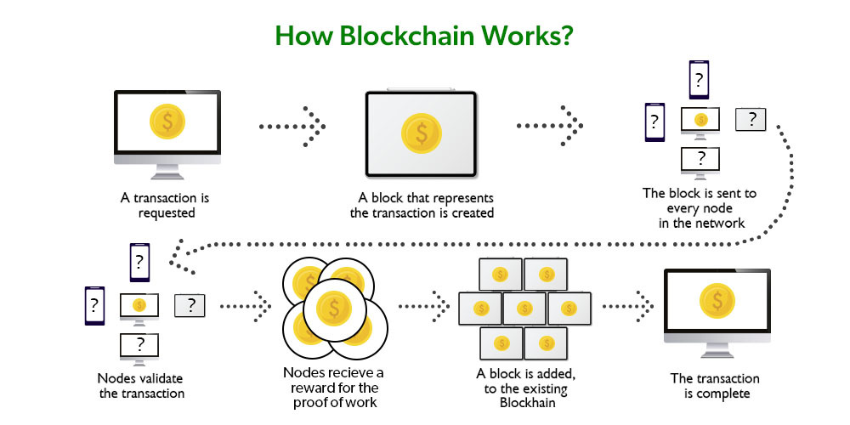
Benefits of Blockchain Technology

Slide 53
Let’s understand this working of blockchain with the help of an example:
Let’s say Jack and Phil are two nodes on the bitcoin blockchain network who wants to carry out a transaction between them.
Step 1: Facilitating the transaction: Jack wants to send 20 BTC to Phil via the Blockchain network.
Step 2: Verification of transaction: The message for verification will be sent to all the nodes on the network. All the nodes will check the important parameters related to the transaction like Does Jack has sufficient balance i.e. at least 20BTC to perform the transaction. Is Jack a registered node? Is Phil a registered node? After checking the parameters the transaction is verified.
Step 3: Formation of a new block: A number of verified transactions stack up in mempools and get stored in a block. This verified transaction will also get stored in a block.

Slide 54
Step 4: Consensus algorithm: Since here we are talking about bitcoins so the Proof-of-Work consensus algorithm will be used for block verification. In proof-of-work, the system assigns the target hash value to a node, and according to this, it must come up with a hash for the new block. The node has to calculate the hash value for the new block that is less than the target value. If two or more miners mine the same block at the same time, the block with more difficulty is selected. The others are known as stale blocks. Mining usually rewards miners with blockchain currency. In this case, the blockchain currency is bitcoin.
Step 5: Addition of the new block in the blockchain: After the newly created block has got the hash value and authentication through proof-of-work only then it will be added to the network and the transaction will mark as complete. Phil will receive 20 BTC from Jack. The new block will be linked to the open end of the blockchain.

Slide 55
Step 6: Transaction complete: As soon as the block is added to the blockchain, the transaction will take place and 20 BTCs will get transferred from Jack’s wallet to Phil’s wallet. The details of the transaction are permanently secured on the blockchain.
Anyone on the network can fetch the information and confirm the transaction. This will help to keep track of all the transactions and to verify whether any user is trying to double spend. For example, if Jack tries to carry out a transaction in the future, the rest of the nodes can check Jack’s past transaction records to check whether Jack has enough balance to carry out the current transaction. If there is enough balance then the transaction will be approved.

Slide 56
Is Blockchain Secure?
In the most basic way, one can think of a blockchain as a linked list. Each of the next items in the list is dependent on the previous item, except for the first block, also known as the genesis block, which is hardcoded into the blockchain. In the blockchain, each block contains the hash of the previous block’s header and a hash of the transactions in the Merkle tree of the current block. In this way, each block is cryptographically chained to the previous block. Let’s understand with an example what happens when someone attempts to change a transaction or block data in a blockchain network.

Slide 57
Suppose, there is a chain of 10 blocks, where the 10th block depends on the 9th block, the 9thblock depends on the 8th block, and so on.
In this way, the 10th block depends on all the previous blocks and the genesis block as well.
If someone tries to change data on the 2nd block, then the attacker will have to change data on all the later blocks as well, otherwise, the blockchain will become invalid since the later blocks depend on the hash value present in the 2nd block and the 2nd block has changed, but not the later blocks.
Thus, as the blocks are added, immutability increases as changing the block is an expensive operation.
Also, to add/change a block in a blockchain, a consensus algorithm is used by nodes in the blockchain network. In order to compensate for the change in one block, one must have to recalculate the hash of every block to update the hash value of the block header in the next block. This will involve a lot of time and computational resources.
In order to succeed with such kind of attack, the hacker has to simultaneously control and change 51% or more copies of the blockchain so that their new copy becomes the majority copy and thus the agreed-upon chain.
Thus, requiring an immense amount of time, money, and computational resources.

Slide 58
References
Text books:
Blockchain Technology: Algorithms and Applications Paperback – 6 December 2023 by Asharaf S.; (Author), Sivadas Neelima (Author), Adarsh S. (Author), Franklin John (Author)
Blockchain Basics: A Non-Technical Introduction in 25 Steps
Book by Daniel Drescher
Websites:
https://ntiprit.gov.in/pdf/blockchainanddistributed/Blockchain_Introduction_KR.pdf
https://bitcoin.org/bitcoin.pdf

Slide 59
THANK YOU

Slide 60
INSTITUTE : UIE
DEPARTMENT : CSE
Bachelor of Engineering (Computer Science & Engineering)
Disruptive Technologies-3
(23CSH-203)
Topic: Blockchain
DISCOVER . LEARN . EMPOWER
Notes:
1

Slide 61
Blockchain

Slide 62
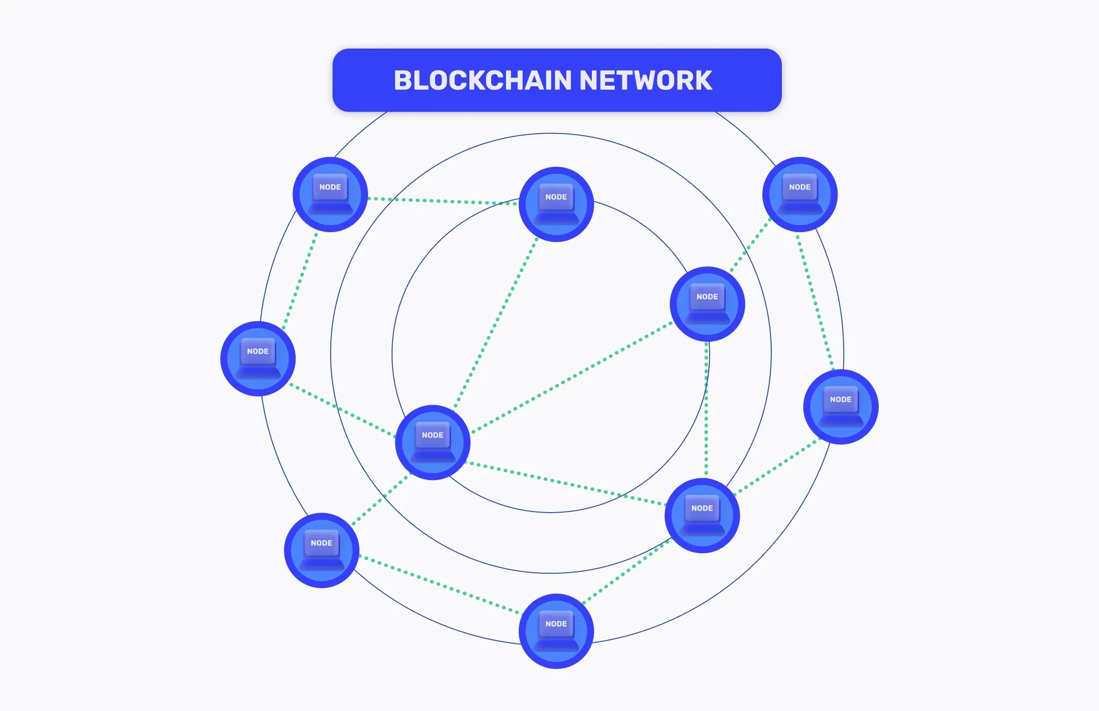
What is Blockchain Network?
A blockchain network is known as a distributed, decentralized, and immutable peer-to-peer digital ledger to record transactions and data from different computer nodes. Generally, Blockchains are created for specific purposes including users getting varied types of tasks or access.
The Blockchain, a ledger of records known as Blocks is connected using cryptography. Every block includes a cryptographic hash of the previous block, transaction data, and a timestamp. Blockchain also abolishes data supplication and increases security via data integrity.

Slide 63
Need for Different Types of Blockchain Networks
There are four main types of Blockchain networks- Public, Private, Hybrid, and Consortium. And here, the question arises why we need these different Blockchain types or networks.
The need for different Blockchain types arises because of diverse requirements and to address specific challenges. Look at the following reasons to know the need for diverse types of Blockchain-
Privacy and Security
Scalability
Smart Contract Capabilities
Cost & Efficiency
Consensus Mechanism
Regulatory Compliance
Interoperability
11

Slide 64
Need for Different Types of Blockchain Networks
1. Privacy and Security
Some specific businesses and industries go for Blockchain services to have augmented privacy and data confidentiality. If they go for a public Blockchain, it reveals all the transactional data to the public, hence they prefer permissioned or private blockchains to limit access & visibility to allowed participants only to ensure confidentiality.
2. Scalability
Top Blockchain development companies use different Blockchain networks as per their capability to manage the number of participants and transactions. Some Blockchain networks are created for high transaction output, making them appropriate for apps that need fast processing, while others also go for decentralization leading to lower scalability. In terms of scalability, some companies are seeking for blockchain staffing solutions.

Slide 65
Need for Different Types of Blockchain Networks
3. Smart Contract Capabilities
Intricate smart contracts are not supported by all types of Blockchains; hence businesses need to use different Blockchain in order to handle them. Different networks cater to different levels of programmability enabling professionals to select the most appropriate platform depending on their app requirements.
4. Cost & Efficiency
The network efficiency and cost of transaction fees may differ significantly based on different Blockchains. Some Blockchain applications may need low-cost transactions, on the other hand, others prioritize efficiency and speed over costs.
5. Consensus Mechanism
Varied Blockchain networks employ different consensus mechanisms such as Proof of Stake, Proof of Work, Delegated Proof of Stake, etc. Also, businesses’ choice of consensus mechanism is based on aspects like energy efficiency, security, block finality, and decentralization.

Slide 66
Need for Different Types of Blockchain Networks
6. Regulatory Compliance
There are various industries and use cases requiring adherence to particular regulatory requirements. In comparison to public Blockchains, permissioned or private Blockchains allow for more control over users and data shared by them aiding compliance with related laws and regulations.
7. Interoperability
There are several Blockchains and distributed ledgers available that have made interoperability vital. Hence, different networks are there to ensure smooth interconnection and secure data exchange allowing smooth data flow across different systems.

Slide 67
Different Types of Blockchain Networks?
There are multiple ways to create Blockchain solutions, but depending on the business use and requirements, it is essential to choose a suitable blockchain network. Every Blockchain is created specifically for a purpose and to address particular issues.
Check out the below different types of Blockchain networks including public, private, hybrid, and consortium-
Public Blockchain
Private Blockchain
Hybrid Blockchain
Consortium Blockchain

Slide 68
1. Public Blockchain
Among all types of Blockchains, Public blockchains are the most used types. These allow everyone to join the network and are fully decentralized. It has a transparent digital ledger that can be accessed by anyone without any restriction or permission.
When it comes to private vs public Blockchain, public blockchains facilitate users for open participation and equal merits to validate and authenticate transactions to the chain. Every user in the network keeps a copy of the entire Blockchain along with security and redundancy.
Public blockchains use consensus mechanisms such as Proof of Stake (PoS) or Proof of Work (PoW). In this, PoW depends on computational power for transaction validation, on the other hand, PoS uses the stake of users AKA cryptocurrency holdings.

Slide 69
Public Blockchain
Advantages:
Having no central authority makes it unaffected by censorship and a single point of failure.
High level of transparency as all transactions are visible publicly resulting in enhanced trust and accountability.
The vast network of nodes provides high-level security and a robust consensus mechanism.
Anyone is allowed to join the network leading to innovation and inclusivity.
Users are incentivized to sustain and validate the Blockchain fostering network sustainability.
Disadvantages:
Public blockchains may have high fees for transactions at the time of heavy network usage.
The PoW consensus mechanism used in some public Blockchains such as Bitcoin requires high computational power and leads to many environmental issues.
Due to the openness, public blockchains can conflict with regulatory requirements in some areas, making it hard to conform to local regulations.

Slide 70
2. Private Blockchain
Private blockchains only allow participants with authorized and validated information. This works as a distributed ledger technology operating in a restricted network, a selected group of participants, and with limited access.
In public vs private blockchains, public blockchains are open to anyone but private blockchains are permissioned reflecting the allowance to only pre-approved participants.
Private blockchains permit organizations to have more control over all the data and processes making them compatible with industry regulations and other policies.
Also, the consensus mechanism is faster and more efficient in comparison to the public blockchain as there are limited participants. It makes private blockchain suitable for enterprise-level apps with paramount privacy and speed.
Above all, private blockchains provide enhanced security as it is only accessible to limited members only leading to less risk of unauthorized access and possible risks.

Slide 71
Advantages:
It provides limited access to only trusted participants alleviating the risk of illegal entry and possible attacks.
Faster transactions and speed along with enhanced data confidentiality and privacy.
A private blockchain can be customized according to specific organizational requirements.
Fewer validators and nodes result in less operational costs in comparison to public blockchains.
Smaller network size results in more efficient consensus mechanisms.
Disadvantages:
Decreased level of decentralization due to a controlled number of participants.
The selected group of validators or authorized nodes can have a single point of failure if any of them gets malfunctions or compromises.
Creating and maintaining a private blockchain can lead to enhanced Blockchain app development costs due to significant investment in administration and infrastructure.

Slide 72
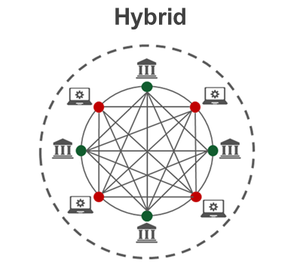
3. Hybrid Blockchain

Slide 73
Hybrid Blockchain
Hybrid Blockchain is among the types of Blockchain networks that is an amalgamation of public and private Blockchain networks. It comprises the best of both networks enabling decentralization, transparency, and immutability similar to public Blockchain. The Hybrid Blockchain network also has some elements of private blockchains such as faster transaction processing and enhanced privacy.
Hybrid Blockchains store confidential transactions and sensitive data on a private network that is only available to authorized participants including consortiums or businesses. On the other hand, less sensitive data will be stored on the public chain leading to inclusivity and openness.
A Hybrid Blockchain network is specifically beneficial for industries such as healthcare, finance, and supply chain management requiring regulatory compliance and secure data handling.

Slide 74
Advantages:
The blend of public and private networks enables higher scalability by adapting a larger number of transactions.
The hybrid approach facilitates organizations to tailor their blockchain infrastructure to align their specific use cases providing more flexibility than a regular solution.
Employing a combination of public and private networks would be more cost-efficient than adopting an entire private blockchain network.
This network is helpful to develop trust between participants as it creates a balance between data confidentiality and openness.
Private chains offer quicker transaction processing in comparison to entire public blockchains to enhance system performance overall.
Disadvantages:
A Hybrid Blockchain network adds complexity to the entire architecture and needs appropriate integration & synchronization between private and public components.
The Hybrid model can have potential attack vectors as both private and public chains require to be secured properly.
The combination of private and public elements may raise governing concerns, particularly about data privacy and compliance in related industries.

Slide 75
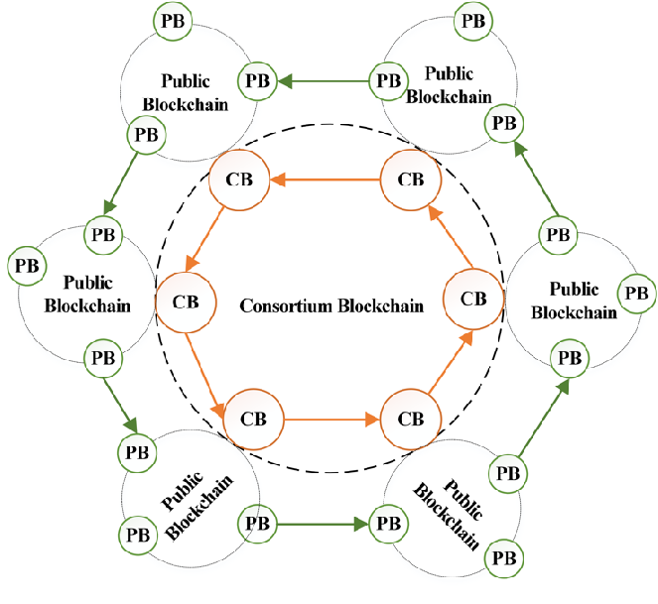
4. Consortium Blockchain

Slide 76
Consortium Blockchain
Consortium Blockchain network works as a distributed ledger technology comprising the benefits of both private and public blockchain networks. In this network, a group of trusted and pre-chosen participants including organizations, companies, or government entities create a network to maintain and authorize the blockchain collaboratively.
Unlike public Blockchains that are open to everyone and private blockchains regulated by a single entity, the Consortium Blockchain network provides a middle way. It allows consortium members to share confidential data securely while continuing transparency and decentralization.
The governance model of consortium blockchain includes a consensus protocol agreed upon by the active individuals to enable validated transactions that are added to the Blockchain ledger transparently.
It leads to enhanced trust and less risk of malicious activities. Overall, consortium blockchains maintain a balance between the decentralization advantages of public blockchains and the controlled access needed for enterprise use cases.

Slide 77
Advantages:
Restricted access to trusted users guarantees the security and confidentiality of sensitive data while lessening the risk of unauthorized access or attacks.
The consortium has a smaller group of validators; hence its consensus mechanism can be faster and more efficient leading to better scalability.
Less need for intricate PoW (proof of work) or consensus algorithms outcomes in transaction fees and lower energy consumption.
This network facilitates smooth collaborations and data distribution between organizations resulting in managed workflows and enhanced interoperability.
The Consortium Blockchain network can be customized to align with the specific requirements of participants which makes it simple to execute industry-specific use cases.
Disadvantages:
Decisions related to consensus mechanisms, updates, and network rules need an agreement among consortium members resulting in possible governance clashes and interruptions in executing changes.
Though consortium blockchains provide more privacy in comparison to public blockchains that can lead to less transparency for external stakeholders and auditors. It makes data accuracy verification harder on the blockchain.
When the Consortium is controlled by strong entities, there is always a risk of collusion in negotiating the justice and neutrality of the network.

Slide 78
Types of Blockchain Protocols
Below are some of the types of blockchain protocols:
1. Hyperledger: Hyperledger is an open-source framework that is developed by Linux. It helps the enterprises to provide blockchain solutions, and how to create a secured blockchain protocol. It was developed in the year 2015. It enables international business transactions. It supports Python and there are many libraries that help in software development. The main aim is to provide universal guidelines for Blockchain implementation.
Advantages:
It provides enhanced services because of the tools and presence of a large number of libraries.
It is open-source hence anyone can contribute.
It helps in international transactions.
Disadvantages:
There is a lack of use cases as well as skilled programmers.
It is not a network fault-tolerant.

Slide 79
Types of Blockchain Protocols
2. Quorum: Quorum is another enterprise blockchain protocol that aims to address the problems related to finance. It is open source project associated with Ethereum. It was developed by JP Morgan. It can change how financial enterprises function and implement blockchain. It is open-source and nowadays has become one of the best enterprise blockchain frameworks.
Advantages:
It has the ability to solve any financial query
It is an open-source framework
It provides better performance and provides an enhanced experience of transaction
Disadvantages:
Lack of scalability
Lack of security and privacy

Slide 80
Blockchain Protocols
3. Corda: Corda is an enterprise protocol. It is handled by the R3 banking consortium. This protocol is useful in the field of banking and financial organizations. It utilizes consensus algorithms to maintain transparency and security. It is also an open-source framework. It allows for the building of interoperable blockchain networks with strict privacy.
Advantages:
It provides enhanced security.
It is stable and scalable
Disadvantages:
It is not very flexible as only parties involved in the transaction can take part in the decision.

Slide 81
Blockchain Protocols
4. Enterprise Ethereum: Ethereum is one of the public blockchain suite protocols. It defines the platform for decentralized applications. It is the blockchain of choice for developers and enterprises, who are creating technology based upon it to change the way many industries operate. However, for private permissioned networks, enterprise Ethereum is used. It is mostly used for privacy, scalability, and improved performance
Advantages:
It is an enhanced version of Ethereum and hence supports more privacy.
It is scalable.
Disadvantages:
It is volatile and has high transaction fees.
It is prone to online hacking.

Slide 82
Blockchain Protocols
5. Multichain: Multichain is an open-source and was established for private blockchain networks. It was developed to help profit-making corporations. It allows to set up of a private blockchain network. It is a private company that offers API for Blockchain development. It is a cross-chain router protocol. It allows users to swap tokens between different blockchains using a bridge.
Advantages:
It helps to establish private blockchains that can be used by certain organizations.
Multichain allows customizing rules for tokens, transaction control, etc.
Disadvantages:
It does not support smart contracts.

Slide 83
References
Text books:
Blockchain Technology: Algorithms and Applications Paperback – 6 December 2023 by Asharaf S.; (Author), Sivadas Neelima (Author), Adarsh S. (Author), Franklin John (Author)
Blockchain Basics: A Non-Technical Introduction in 25 Steps
Book by Daniel Drescher
Websites:
https://ntiprit.gov.in/pdf/blockchainanddistributed/Blockchain_Introduction_KR.pdf
https://bitcoin.org/bitcoin.pdf

Slide 84
THANK YOU

Slide 85
INSTITUTE : UIE
DEPARTMENT : CSE
Bachelor of Engineering (Computer Science & Engineering)
Disruptive Technologies-3
(23CSH-203)
Topic: Blockchain
DISCOVER . LEARN . EMPOWER
Notes:
1

Slide 86
Bitcoin

Slide 87
What is Bitcoin
There are a number of currencies in this world used for trading amenities. Rupee, Dollar, Pound Euro, and Yen are some of them. These are printed currencies and coins and you might be having one of these in your wallet. But bitcoin is a currency you can not touch, you can not see but you can efficiently use it to trade amenities. It is an electronically stored currency. It can be stored in your mobiles, computers, or any storage media as a virtual currency. Bitcoin is an innovative digital payment system. It is an example of a cryptocurrency and the next big thing in finance.
It is a virtual currency designed to act as money and outside the control of any person or group thus eliminating the need for third-party in financial transactions.
It is used as a reward for the miners in bitcoin mining.
It can be purchased on several exchanges.

Slide 88
There are 3 ways you can get a bitcoin in your electronic storage:
Trade Money For Bitcoin: Say that the value of a bitcoin is 1 lakh rupees, so if you want a bitcoin, you can trade a bitcoin in place of 1 lakh rupees. This Bitcoin will further be stored in your electronic storage media which you can further use.
Trade Goods For Bitcoin: Say that the value of a bitcoin is 1 lakh rupees and you have a commodity that has its value as 1 lakh rupees, so you can trade that commodity in place of a bitcoin, and the bitcoin will be stored in your electronic storage media.
Mine Bitcoins: Other than trading, you can also mine bitcoins. Since it is a decentralized currency, there is no authority that brings bitcoins into the market. Bitcoins only come into the market by mining them.
11

Slide 89
Features:
Distributed: All bitcoin transactions are recorded in a public ledger known as the blockchain. There are nodes in the network that maintain copies of the ledger and contribute to the correct propagation of the transactions following the rules of the protocols making it impossible for the network to suffer downtime.
Decentralized: There is no third party or no CEO who controls the bitcoin network. The network consists of willing participants who agree to the rules of a protocol and changes to the protocol are done by the consensus of its users. This makes bitcoin a quasi-political system.
Transparent: The addition of new transactions to the blockchain ledger and the state of the bitcoin network is arrived upon by consensus in a transparent manner according to the rules of the protocol.
Peer-to-peer: In Bitcoin transactions, the payments go straight from one party to another party so there is no need for any third party to act as an intermediary.

Slide 90
Features:
Censorship resistant: As bitcoin transactions are pseudo-anonymous and users possess the keys to their bitcoin holdings, so it is difficult for the authorities to ban users from using their assets. This provides economic freedom to the users.
Public: All bitcoin transactions are available publicly for everyone to see. All the transactions are recorded, which eliminates the possibility of fraudulent transactions.
Permissionless: Bitcoin is completely open access and ready to use for everyone, there are no complicated rules of entry. Any transaction that follows the set algorithm will be processed with certainty.
Pseudo-anonymous: Bitcoin transactions are tied to addresses that take the form of randomly generated alphanumeric strings.

Slide 91
How Do Bitcoin Transactions Work?
Bitcoin transactions are digitally signed for security. Everyone on the network gets to know about a transaction. Anyone can create a bitcoin wallet by downloading the bitcoin program. Each bitcoin wallet has two things:
Public key: It is like an address or an account number via which any user or account can receive bitcoins.
Private key: It is like a digital signature via which anyone can send bitcoins.
The public key can be shared with anyone but the private key must be held by the owner. If the private key gets hacked or stolen then bitcoin gets lost.
A bitcoin transaction contains three pieces of information:
Private key: The first part contains the bitcoin wallet address of the sender i.e. the private key.
Amount of bitcoin to be transferred: The second part contains the amount that has been sent.
Public key: The third part contains the bitcoin wallet address of the recipient i.e. the public key.

Slide 92
Benefits of Bitcoin
The following are some of the advantages of using bitcoins:
User anonymity: Bitcoin users can have multiple public keys and are identified by numerical codes. This ensures that the transactions cannot be traced back to the user. Even if the wallet address becomes public, the user can generate a new wallet address to keep information safe.
Transparency: Bitcoin transactions are recorded on the public ledger blockchain. The transactions are permanently viewable, which gives transparency to the system but they are secure and fraud-resistant at the same time due to blockchain technology.
Accessibility: Bitcoin is a very versatile and accessible currency. It takes a few minutes to transfer bitcoins to another user, so it can be used to buy goods and services from a variety of places accepting bitcoins. This makes spending bitcoin easy in another country with little or no fees applied.
Independence from central authority: Bitcoin is a decentralized currency, which means there is no dependence on any single governing authority for verifying transactions. This means that the authorities are not likely to freeze or demand back the bitcoins.
Low transaction fees: Standard wire transfers involve transaction fees and exchange costs. Since bitcoin transactions do not involve any government authority so the transaction fees are very low compared to bank transfers.

Slide 93
Drawbacks of Bitcoin
The following are some of the cons of using bitcoin:
Volatility: There are various factors that contribute to the bitcoin’s volatility like uncertainty about its future value, security breaches, headline-making news, and one of the most important reasons is the scarcity of bitcoins. It is known that there is a limit of 21 million bitcoins that could ever exist which is why some regard bitcoin as a scarce resource. This scarcity makes bitcoin’s price variable.
No government regulations: Unlike the investments that are done through central banks, bitcoins transactions are not regulated by any central authority due to a decentralized framework. This means that bitcoin’s transactions don’t come with legal protection and are irreversible which makes them susceptible to crimes.
No buyer protection: If the goods are bought using bitcoins and the seller does not send the promised goods then nothing can be done to reverse the transactions and since there is no central authority so no legal protection can be provided in this case.
Not widely accepted: Bitcoins are still only accepted by a small group of online merchants. This makes it unfeasible to rely completely on bitcoin as a currency and replace it with traditional bank transactions.
Irreversible: There is a lack of security in bitcoin transactions due to the anonymous and non-regulated nature of the bitcoin transactions. If the wrong amount is sent or the amount is sent to the wrong recipient then nothing can be done to reverse the transactions.

Slide 94
What is Bitcoin Mining?
Bitcoin mining is a complex computational and technological process of validating the bitcoin transactions over the Bitcoin network. It is like a process of validating a block on the chain network and getting paid in Bitcoin.
People who are involved in this process of mining are known as miners. The reason why it is called ‘mining’, is because just like any other form of natural resources, there is a finite number of Bitcoins available. The maximum amount of Bitcoin that can be created or mined is 21 million. Just like real mining, in Bitcoin mining, one needs to invest energy in order to generate or create Bitcoins. And here, the energy is in the form of electrical energy to mine Bitcoins. The miners compete against each other to solve complex hash puzzles, which are encoded cryptographically to verify the blocks containing transactions.
In this race of guessing, whosoever becomes the first miner to guess the number gets a chance to update the ledger of transactions on the Bitcoin blockchain network and also receives a reward of newly-minted Bitcoins. It is to be noted that this guessing of specific numbers is all done by the computer. So, the more powerful a computer one has, the more guesses a miner can make per second, and thus it increases the chances of winning this race. Bitcoin mining is primarily done:
A) To bring new coins into circulation and validate ongoing transactions.
B) To check counterfeiting and double-spend.
C) Maintain the ledger in a decentralized manner.

Slide 95
How Does Bitcoin Mining Work?
Let’s break down the mining process to understand how it works and what is required to start the process:
Setting-up Of Powerful Hardware Resources
Before a miner can initiate the process of minting Bitcoins, they need to set up their own rigs in terms of powerful computer resources and other specific tools to solve the complex puzzles efficiently. As mining hardware, they would require either graphics processing units (GPUs) with advanced graphic cards, field programmable gate array (FPGAs), or application specific integrated circuits (ASICs) for efficient and effective mining.
At present, ASIC-based hardware is the most advanced and capable of creating huge amounts of hashes per second. However, such advanced hardware is costly and may range in thousands of dollars.

Slide 96
Installing Mining Software and E-Wallets
Other than powerful hardware requirements, miners need specific software such as CG miner, XMR miner, multiminer. Many of this software are free to download and can run on Windows and Mac computers. Once the software is connected to the necessary hardware, you are all set for Bitcoin mining.
The miner would also require an e-wallet to store their rewards as Bitcoins. A bitcoin wallets a digital place that facilitates in storing, transferring and accepting Bitcoin or other cryptocurrencies.
Mining Pool or Solo Mining
Miners can opt whether they want to mine solo or go for pool mining. As it is not that easy to mine alone, mining pools were invented. In a mining pool, groups of miners are formed together to deal with the growing difficulty of mining. Each miner is paid for their share of work.
Mining Bitcoins in a pool with combined computation power also promotes efficient mining with reduced mining difficulty to solve a block. This also promotes the participation of small miners to have a chance of earning Bitcoin, even though they will only receive a certain part of the reward.
More Miners = Reliable + more secured network

Slide 97
Types Of Bitcoin Mining
Bitcoin mining can be done in several ways and forms, each delivering different levels of hashing power and block rewards. Here are the various ways that one can mine Bitcoin:
CPU Mining
When Bitcoin was launched in 2009 and was mined for the first time, it got mined via central processing units (CPUs), which is also known as the brain of a computer, containing all the circuitry required to process input and output results. In the early days of Bitcoins, it was easy to mine it via CPUs as there were only very few miners and Bitcoin was also at its infant stage.
GPU Mining
Gradually when the acceptance and popularity of Bitcoin increased over the time, along with the competition among miners, graphics processing units (GPU) mining came into the picture.
GPUs based systems, which are mainly used for gaming, modern video editing, proved to be more efficient for mining with better hash rate than CPUs. The first software for GPU mining was launched in 2010. However, the GPU mining of Bitcoin was fairly short lived and got replaced by a new kind of hardware- ASIC by 2015.

Slide 98
Types Of Bitcoin Mining
ASIC Mining
ASIC is a short for application-specific integrated circuit is a kind of hardware which is designed for mining cryptocurrencies only. It was launched in 2012, and proved to be 200 times more powerful than basic GPU miners. However, ASIC mining rigs are very expensive, with prices ranging from $2,000 to $15,000. With varying power consumption and electricity costs along with network difficulties, purchasing ASIC miners could be very high-priced.
FPGA Mining
FPGA stands for field-programmable gate array (FPGA), which is a better choice between GPU miners and ASIC miners in terms of speed and cost efficiency. FPGAs are also able to stabilize vigorous hashing power as they are not meant to be locked into mining a specific coin or algorithm like ASIC miners. The kind of hardware technology gives flexibility to the miner to reuse the set-up if they change your mining activity for something else. FPGA miners are good options for crypto enthusiasts that don’t want to invest huge sums on mining hardware.
Cloud Mining
This is a latest way of mining Bitcoins, where the miner can buy a cloud mining service or purchase a contract from a cloud mining provider who is specialized in cryptocurrency mining rigs. This facilitates the miner to mine Bitcoins without bearing the sunk costs and maintenance requirements of mining hardware set up. But one is required to be very cautious in order to choose a reputed cloud miner to avoid any kind of scams or frauds.

Slide 99
References
Text books:
Blockchain Technology: Algorithms and Applications Paperback – 6 December 2023 by Asharaf S.; (Author), Sivadas Neelima (Author), Adarsh S. (Author), Franklin John (Author)
Blockchain Basics: A Non-Technical Introduction in 25 Steps
Book by Daniel Drescher
Websites:
https://ntiprit.gov.in/pdf/blockchainanddistributed/Blockchain_Introduction_KR.pdf
https://bitcoin.org/bitcoin.pdf

Slide 100
THANK YOU

Slide 101
INSTITUTE : UIE
DEPARTMENT : CSE
Bachelor of Engineering (Computer Science & Engineering)
Disruptive Technologies-3
(23CSH-203)
Topic: Blockchain
DISCOVER . LEARN . EMPOWER
Notes:
1

Slide 102
Bitcoin

Slide 103
Difference between Blockchain and a Database
Database: Generally a database is a data structure which is used for storing information. It is a organised collection or storage of data which is able to store a new data or access a existing data. The data stored in a database can be organized using a database management system. The database administrator can modify the data stored in the database. A database is implemented using the client-server network architecture.
Blockchain: A blockchain is a growing list of records, called blocks, that are linked using cryptography. Each block contains a cryptographic hash of the previous block, a timestamp, and transaction data. Here, modification of data is not permissible by design. It allows decentralized control and eliminates the risks of modification of data by other parties with sufficient access to the system.
Key differences between Blockchain and a Database are:

Slide 104
Database | Blockchain
Database uses centralized storage of data. | Blockchain uses decentralized storage of data.
Database needs a Database admin or Database administrator to manage the stored data. | There is no administrator in Blockchain.
Modifying data requires permission from database admin. | Modifying data does not require permission. Users have a copy of data and by modifying the copies does not affect the master copy of the data as Blockchain is irresistible to modification of data.
Centralized databases keep information that is up-to-date at a particular moment | Blockchain keeps the present information as well as the past information that has been stored before.
Centralized databases are used as databases for a really long time and have a good performance record, but are slow for ertain functionalities. | Blockchain is ideal for transaction platform but it slows down when used as databases, specially with large collection of data.
11

Slide 105
Blockchain vs. Cloud Computing
Since we are familiar with both the terms and their features, let us now see the significant differences between them:
1. A cloud is something that we can gain access to through the internet. It is cyberspace where we can access the data online. On the other hand, blockchain is an encrypted system that uses different styles of encryption and hash to store data in protected databases. The system distributes these data records over various nodes and forms a consensus on the position of the data they contain.
Data in the form of records are immutable in blockchain, whereas data residing in the cloud are mutable. Blockchain does not provide any service as it is a magnificent technological advancement that is a decentralized, distributed ledger that keeps a record of the provenance of a digital asset.
On the other hand, Cloud is a computing service that provides services in three principal formats such as Software as a Service (SaaS), Platform as a Service (PaaS), and Infrastructure as a Service (IaaS). Blockchain guarantees the prevention of the tempering of data without relying on any third-party trusted centralized authority, whereas the cloud does not assure complete integrity and tamper-free data.

Slide 106
What is Blockchain as a Service?
Blockchain as a Service (BaaS) is a managed blockchain service that a third party provides in the cloud. You can develop blockchain applications and digital services while the cloud provider supplies the infrastructure and blockchain building tools. All you have to do is customize existing blockchain technology, which makes blockchain adoption faster and more efficient.
What are AWS Blockchain services?
AWS Blockchain services provide purpose-built tools to support your requirement. You can use them to build everything from a centralized ledger database that maintains an immutable record of transactions to a multi-party, fully managed blockchain network that helps eliminate intermediaries. AWS has numerous validated blockchain solutions from partners who support all major blockchain protocols, including Hyperledger, Corda, Ethereum, Quorum, and more. As a result, you can develop blockchain and ledger applications more easily, quickly, and efficiently with AWS. Some useful AWS Blockchain services are as follows:
Amazon Quantum Ledger Database (QLDB) is a fully managed ledger database that provides a transparent, immutable, and cryptographically verifiable transaction log. It has a built-in journal that stores an accurate and sequenced entry of every data change. The journal is append-only, meaning that users can add data to the journal but cannot overwrite or delete it.

Slide 107
What's the Difference Between Containers and Virtual Machines?
Containers and virtual machines are technologies that make your applications independent from your IT infrastructure resources. A container is a software code package containing an application’s code, its libraries, and other dependencies. Containerization makes your applications portable so that the same code can run on any device. A virtual machine is a digital copy of a physical machine. You can have multiple virtual machines with their own individual operating systems running on the same host operating system. In addition you can create a virtual machine that contains everything required to run your application.

Slide 108
Where are containers and virtual machines used?
Containers and virtual machines are both deployment technologies. In the software development lifecycle, deployment is the mechanism that makes an application run efficiently on a server or device. The application requires several additional software components called dependencies that are closely related to the underlying operating system of the server. All these different software layers between the application code and the physical device are called the application environment.

Slide 109
Challenges in software deployment
Organizations typically have to deploy applications in multiple environments—for example, developing on the Linux environment and testing on Windows—before releasing new features. Moving the application between environments can result in bugs and glitches, which lower productivity, due to missed dependencies. At the same time, building and testing the application in just one environment limits its usefulness. Here are some examples:
You may have to develop different versions for users with different operating systems
Your system administrators must update and maintain all environments uniformly, increasing development costs
You may find it challenging to move your applications from on-premises data centers to the cloud or between different cloud environments

Slide 110
Purpose of virtual machines
Historically, virtual machine technology was developed to efficiently use increasing physical hardware capacity and processing power. Running a single application environment on a single physical server underutilized hardware resources. Virtual machines allow organizations to install multiple operating systems and create multiple environments on the same physical machine.
Purpose of containers
Containers were created to package and run applications in a predictable and repeatable way across multiple environments. Instead of recreating the environment, you packaged the application to run on all types of physical or virtual environments. This is similar to putting an astronaut in a spacesuit instead of recreating the Earth's atmosphere for them on another planet.

Slide 111
Similarities between containers and virtual machines
Containers and virtual machines allow for the full isolation of applications so that you can run them in multiple environments. They virtualize or abstract underlying infrastructure, so users don't have to worry about that. They also allow you to package your software infrastructure into a single file called an image file. You can use the image file to quickly set up and run your application anywhere. In addition, you can also use software processes to manage system configurations or scale to manage thousands of applications at once. However, the role and extent of use for containers and virtual machines vary depending on where and how the application is deployed.

Slide 112
Characteristics | Container | Virtual machine
Definition | Software code package containing an application’s code, its libraries, and other dependencies that make up the application running environment. | Digital replica of a physical machine. Partitions the physical hardware into multiple environments.
Virtualization | Virtualizes the operating system. | Virtualizes the underlying physical infrastructure.
Encapsulation | Software layer above the operating system required for running the application or application component. | Operating system, all software layers above it, multiple applications.
Technology | Container engine coordinates with the underlying operating system for resources. | Hypervisor coordinates with underlying operating system or hardware.
Size | Lighter weight (think in terms of MB). | Much larger (think in terms of GB).
Control | Less control of the environment outside the container. | More control over the entire environment.
Flexibility | More flexible. You can quickly migrate between on-premises and cloud-centered environments. | Less flexible. Migration has challenges.
Scalability | Highly scalable. Granular scalability possible with microservices. | Scaling can be costly. Requires switching from on-premises to cloud instances for cost-effective scale.
 | Learn more about Containers | Learn more about Virtual Machines

Slide 113
How can AWS help with your containers and virtual machines?
AWS has several services to support all your application deployment needs. Here are some examples:
AWS App2Container is a containerization tool that allows software developers to modernize legacy applications. Developers use AWS App2Container to turn Java and .NET applications into containerized applications.
Amazon Elastic Container Registry (Amazon ECR) is a highly available and secure private container repository that makes it easy to store and manage Docker container images.
Amazon Elastic Container Service (Amazon ECS) is a highly scalable, high-performance container orchestration service to run Docker containers on the AWS Cloud.
Amazon Elastic Compute Cloud (Amazon EC2) lets you exercise granular control over your cloud instances and choose the processors, storage, and networking you want.
AWS Fargate is a technology for Amazon ECS that lets you run Docker containers without deploying or managing infrastructure.
VMWare Cloud on AWS lets you simplify and accelerate the migration of mission-critical production workloads from on-premises virtual machines to the AWS Cloud.

Slide 114
References
Text books:
Blockchain Technology: Algorithms and Applications Paperback – 6 December 2023 by Asharaf S.; (Author), Sivadas Neelima (Author), Adarsh S. (Author), Franklin John (Author)
Blockchain Basics: A Non-Technical Introduction in 25 Steps
Book by Daniel Drescher
Websites:
https://ntiprit.gov.in/pdf/blockchainanddistributed/Blockchain_Introduction_KR.pdf
https://bitcoin.org/bitcoin.pdf

Slide 115
THANK YOU

